Slide 1
On the microeconomics of smallholder agricultural development
Chris Barrett
Cornell-OXFAM Short Course on
Integrated Land Management for Behind the Brands
May 23, 2019

Slide 2
A few key ideas
A few key ideas from “development microeconomics”: the study of constrained choices by individuals, firms and groups in developing economies.
Who gains from technological advances? Why?
2) Markets as akin to technologies
3) ‘Market failures’, heterogeneous behaviors, and ‘displaced distortions’.
Understanding the logic of constrained choice: need to contextualize the incentives and constraints people face.

Slide 3
Technological change
“Technology treadmill” and gains from change
Irony: big winners from crop varietal improvement, etc. are typically consumers not producers. Why?
Naïve model
Demand is perfectly elastic. Gains accrue to producers.
But when, if ever, does this really happen?
Small-scale change: early adopters
Perfect market integration … export surplus production
New Supply
Price
Original Supply
Demand
P
Producer
Surplus
Added Producer
Surplus
Quantity

Slide 4
Technological change
“Technology treadmill” and gains from change
Irony: big winners from crop varietal improvement, etc. are typically consumers not producers. Why?
Price
More realistic model
Price inelastic demand.
Fallacy of composition: what’s true at small scale (tech. change profitable for first few adopters) not true at large scale.
Distributional logic behind public financing of agricultural research
Demand
New Supply
Original Supply
Consumer
Surplus
P ^{old}
Old Producer
Surplus
New Consumer
Surplus
P ^{new}
New Producer
Surplus
Quantity

Slide 5
Poverty and tech. change
Q: So if poor often late adopters and producers gain little, why does tech change in ag. reduce poverty?
A: The poor are routinely net food buyers and gain from lower food prices. Moreover, commonly gain proportionately more than net sellers lose.
Net benefit ratio: A handy statistic to estimate the (instantaneous) welfare effects of price changes.
NBR = net sales/total income
Example: Net rice sales/
marketable surplus by land
holdings, Madagascar 1990
Source: Barrett and Dorosh (AJAE 1996)

Slide 6
Markets as technologies
Markets as akin to technologies
From a household’s perspective, market exchange is like a production technology:
one way to ‘produce’ good 1 is to produce some
other good 2 and then exchange it for good 1.
Market participation is therefore like technology adoption and can be studied similarly:
… in both cases, fixed costs and risk matter a lot
… easy to get trapped in a low-level eqln
So just as technological change in agriculture is central to poverty reduction, so is the growth of agricultural marketing channels.

Slide 7
Ag household models
Core of smallholder agricultural household models:
Households are both producers and consumers of key products – e.g., food – and value things that might not be fully tradable – e.g., relationships, status, land.
(Perhaps infinitely) costly access to distinct factor (input) and product (output) markets and technologies convert these endowments (of land, labor, etc.) into food, cash income, etc.
Households have objectives, which may relate to material (e.g., cash, food) or non-material (e.g., conformity to behavioral norms, altruism) flows or to stocks (e.g., wealth, health, relationships).

Slide 8
Ag household models
Key implications of household models
1) Anything that impacts household production decisions affects consumption – “profit effects”. But households typically NOT profit maximizers.
Iff all markets function perfectly, then households behave as if they maximize profits – to give themselves as much choice as possible – and then allocate the resulting total income according to their preferences.
But this separable household model assumption is generally a fiction in low-income rural settings where multiple market failures are the norm.

Slide 9
Ag household models
2) Market failures may be household/individual-specific (“idiosyncratic”). Risk, transactions costs, etc. drive a wedge between observed market prices and the “shadow price” faced by a household or individual. Consumption and production behaviors are non-separable consumption decisions influence production and exchange decisions not just vice versa (as in the separable case).
3) “price bands”:HHs self-select out of mkts. Autarky requires adeq. endowments. HH-specific shadow prices reflect HH endowments.

Slide 10
Example: Rice market participation by land holdings, Madagascar 1990
Some empirical regularities
Source: Barrett and Dorosh (AJAE 1996)

Slide 11
Household models
Variation in shadow prices leads to seemingly puzzling “displaced distortions”. Examples:
1. Seeming misallocation of labor on-farm: labor market search costs, credit access, price risk exposure, etc. lead to “rational variation” from the usual allocative efficiency criterion (wage = marginal revenue product of labor)
Example: Labor allocation by rice farmers in Côte d’Ivoire. AI≡w/MRP_{L} falls as land/labor endowment increases. ln(AI)> (<) 0 means farmers over- (under-) employ labor relative to market wage. Causes significant inter-farm productivity differences even when everyone faces the same market prices and uses the same technologies.

Slide 12
Household models
2. Sell low/buy high marketing behaviors: maize in Kenya (Stephens and Barrett J. Agr. Econ. 2011)
Faced with sharp seasonality in prices, farmers often sell at post-harvest lows even when they know they will buy back at lean season highs, simply because they lack credit access and need cash.

Slide 13
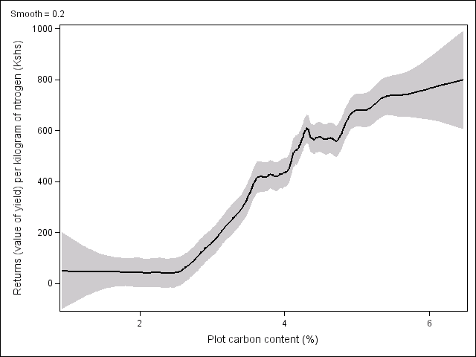
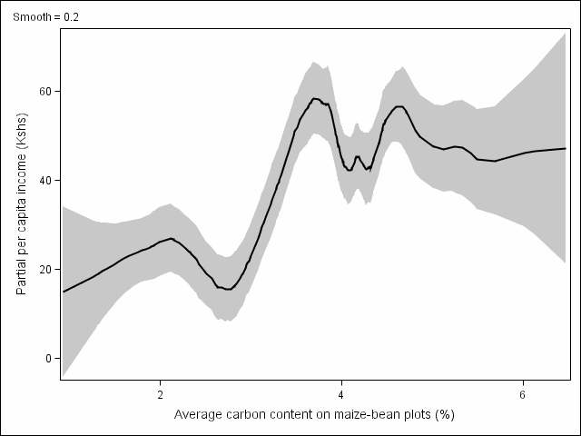
Household models
3. Non-uptake of seemingly promising technologies: SRI in Madagascar and seasonal credit/labor requirements (Moser and Barrett 2006) or improved NRM practices in western Kenya and complementarities with livestock, land and cash endowments (Marenya and Barrett 2007) or inorganic fertilizer use in western Kenya (Marenya and Barrett 2009).
Above red line: fertilizer profitable
Value of maize from 1 kg of nitrogen
Cost of 1kg nitrogen
Below red line: fertilizer unprofitable
(Source: Marenya and Barrett, American J. Agricultural Economics, 2009).

Slide 14
Summary
Development microeconomists seek to understand the incentives and constraints people face as they make choices. Helps resolve puzzles and identify entry points for improving options. We focus on:
assets/endowments individuals or households control
their preferences
accessible production technologies and markets
risk exposure and management (incl. formal/informal finance)
how natural, institutional (e.g., market) and policy environments affect incentives and constraints.
A focus on constrained choice offers many illuminating insights on what sometimes seem puzzling behaviors.

